Slide 1
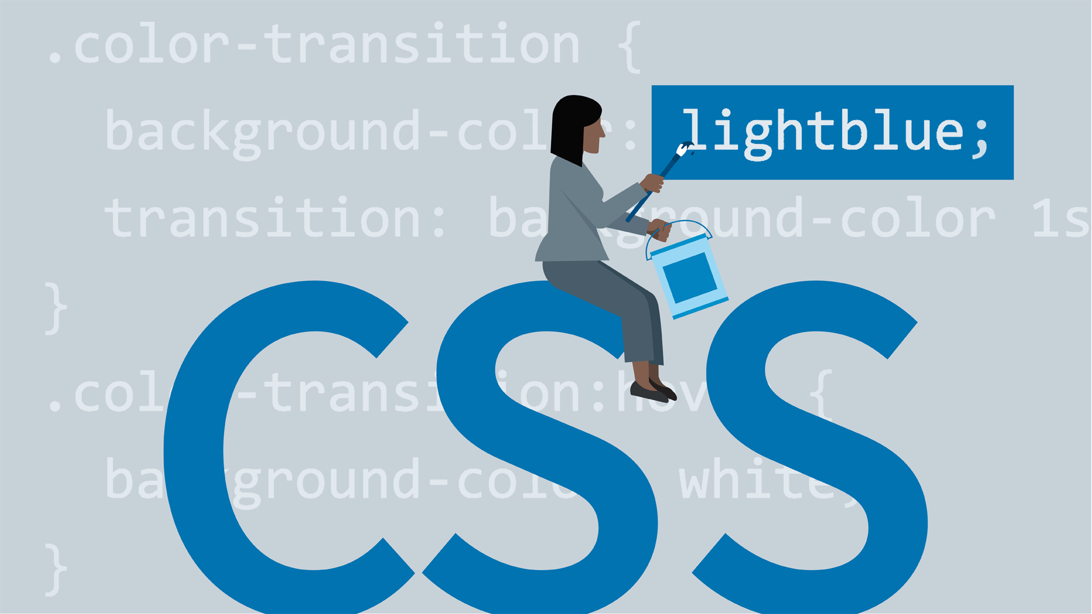

Slide 2
CSS
CSS is the acronym for: ‘Cascading Style Sheets’.
CSS allows you to style your web pages.
CSS describes how HTML elements should be displayed.

Slide 3
Examples
body { background-color: grey; } h1 { color: white; text-align: center; } p { font-family: verdana; font-size: 25px; }

Slide 4
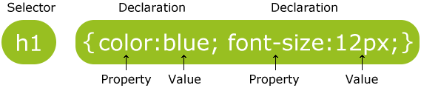
CSS Syntax
A CSS rule-set consists of a selector and a declaration block:
p { color: red; text-align: center; }

Slide 5
CSS Selectors
Element Selector
Id Selector
Class Selector
Universal Selector
Group Selector

Slide 6
CSS Element Selector
<style>
p{
text-align: center;
color: blue;
}
</style>
</head>
<body>
<p>This style will be applied on every paragrap</p>

Slide 7
id Selector
The id selector uses the id attribute of an HTML element to select a specific element.
The id of an element should be unique within a page so it is chosen to select a single, unique element.
It is written with the hash character (#), followed by the id of the element.
An id name cannot start with a number

Slide 8
<style>
#p1 {
text-align: center;
color: blue;
}
</style>
</head>
<body>
<p id=“p1">Welcome to My Page</p>
<p>This paragraph will not be affected.</p>
</body>
</html>

Slide 9
<html>
<head>
<style>
#s1{
color:orange;
}
</style>
</head>
<body>
<p id=s1>
This is a paragraph
</p>
<h1>hello</h1>
</body>
</html>

Slide 10
class Selector
To select elements with a specific class, write a period .(dot Symbol) character, followed by the name of the class.
.center { text-align: center; color: red; }

Slide 11
<html>
<head>
<style>
.sty1
{
color:red;
text-align:center;
}
</style>
</head>
<body>
<p class=sty1>
This is a paragraph
</p>
<h1>hello</h1>
</body>
</html>

Slide 12
You can also specify that only specific HTML elements should be affected by a class.
p.center { text-align: center; color: red; }
<p class=“center”>Hello</p>

Slide 13
HTML elements can also refer to more than one class.
<p class="center large">This paragraph refers to two classes.</p>

Slide 14
Universal Selectors
The * selector selects all elements.
The * selector can also select all elements inside another element
* {
color: red;
}

Slide 15
Select all elements inside <div> elements and set their background color to yellow:
div * { background-color: yellow; }

Slide 16
<html>
<head>
<style>
div * {
background-color: yellow;
}
</style>
</head>
<body>
<h1>Welcome to My Homepage</h1>
<div class=“c1">
<p>My page</p>
<p>Welcome</p>
</div>
<p>End of My Page<p>
</body>
</html>

Slide 17
Grouping Selectors
It will be better to group the selectors, to minimize the code.
To group selectors, separate each selector with a comma.
h1, h2, p { text-align: center; color: red; }

Slide 18
Descendant Selectors
Used to apply a style rule to a particular element only when it lies inside a particular element.
element element
div p
Selects all <p> elements inside <div> elements

Slide 19
<html>
<head>
<style>
div p {
background-color: yellow;
}
</style>
</head>
<body>
<h1>Welcome to My Homepage</h1>
<div>
<h2>Jagran Inst. of Mgt.</h2>
<p> Saket Nagar ,Kanpur</p>
</div>
<p>Course PGDM | MCA</p>
</body>
</html>

Slide 20
Note
div p {
background-color: yellow;
}
This code will also work if we write
<div>
<h3><p>Hello</p></h3>
Because<p> is still inside <div> element

Slide 21
Child Selectors
Very similar to descendants but have different functionality.
body > p { color:grey; }
This rule will render all the paragraphs in black if they are direct child of <body> element. Other paragraphs put inside other elements like <div> or <td> would not have any effect of this rule.

Slide 22
<html>
<head>
<style>
div > p {
background-color: Orange;
}
</style>
</head>
<body>
<h1>Welcome to My Homepage</h1>
<div>
<h2>Jagran Inst. of Mgt.</h2>
<p> Saket Nagar ,Kanpur</p>
</div>
<p>Course PGDM | MCA</p>
</body>
</html>

Slide 23
Select and style every <p> element that are placed immediately after <div> elements:
div + p { background-color: yellow; }

Slide 24
[attribute] Selector
The [attribute] selector is used to select elements with the specified attribute.
Syntax
Element [attribute] { css declarations; }

Slide 25
<html>
<head>
<style>
input[type = "text"]
{
color: red;
}
</style>
</head>
<body>
<form>
<input type="text" name="t1">
</form>
</body>
</html>

Slide 26
CSS reference
::after
::before
::first-letter

Slide 27
p::after { content: " - Important"; }
p::before { content: url('images/image.png'); }

Slide 28
<html>
<head>
<style>
p::before {
content: “Note-";
}
</style>
</head>
<body>
<p>Jagran Inst. Of Mgt.</p>
<p></p>
</body>
</html>

Slide 29
p::first-letter { font-size: 200%; color: red; }

Slide 30
CSS Comments
/* This is a single-line comment */
/* This is a multi-line comment */

Slide 31
Ways to Insert CSS in HTML
Inline style
Internal style sheet
External style sheet

Slide 32
Inline Styles
An inline style may be used to apply a unique style for a single element.
<h1 style="color:blue;margin-left:30px;">This is a heading</h1>

Slide 33
Internal Style Sheet
It is used if one single page has a unique style.
<head>
<style>
body {
background-color: lightgrey;
}
h1 {
color: maroon;
margin-left: 50px;
}
</style>
</head>

Slide 34
External Style Sheet
With an external style sheet, you can change the look of an entire website by changing just one file
<head> <link rel="stylesheet" type="text/css"
href="mystyle.css">
</head

Slide 35
Alternative code
<head>
<style>
@import "myStyleSheet1.css";
</style>
</head>

Slide 36
CSS Rules Overriding
Any inline style sheet takes highest priority. So, it will override any rule defined in <style>...</style> tags or rules defined in any external style sheet file.
Any rule defined in <style>...</style> tags will override rules defined in any external style sheet file.
Any rule defined in external style sheet file takes lowest priority, and rules defined in this file will be applied only when above two rules are not applicable.

Slide 37
CSS Backgrounds
CSS background properties:
background-color
background-image
background-repeat
background-attachment
background-position

Slide 38
CSS Colors
<h1 style="background-color:grey;">Hello World</h1>
<h1 style="color:red;">Hello World</h1>

Slide 39
background-color: lightblue;
background-image: url(“img.jpg");

Slide 40
background-position
The position of the image is specified by the background-position property:
background-position: left top
background-position: bottom right

Slide 41
CSS Backgrounds
body {
background-color: green; background-image: url("paper.gif");
background-repeat: repeat-x| repeat-y | no-repeat | repeat (default);
background-position: left top;
background-attachment: fixed /scroll; }

Slide 42
Repeat Backgroung Image
repeat-x will repeat a background image only horizontally.
background-repeat: repeat-x;
Repeat-y will repeat a background image only vertically.
background-repeat: repeat-y;
background-repeat: repeat; {default}
background-repeat: no-repeat;

Slide 43
Background position
background-position: right top;
background-position: bottom right;
background-position: 100px;
background-position: 50px 70px;

Slide 44
CSS BORDER
The border properties allow you to specify how the border of the box representing an element should look.
There are three properties of a border you can change:
The border-color specifies the color of a border.
The border-style specifies whether a border should be solid, dashed line, double line, etc.
The border-width specifies the width of a border.
The border-radius property defines the radius of the element's corners.

Slide 45
border-style Property
none: No border. (Equivalent of border-width:0;)
solid: Border is a single solid line.
dotted: Border is a series of dots.
dashed: Border is a series of short lines.
double: Border is two solid lines.
groove: Border looks as though it is carved into the page.
ridge: Border looks the opposite of groove.
inset: Border makes the box look like it is embedded in the page.
outset: Border makes the box look like it is coming out of the canvas.
hidden: Same as none, except in terms of border-conflict resolution for table elements.

Slide 46
Example
p { border-style: solid; border-width: 5px;
border-color: green;
}

Slide 47
Example
<style>
div {
border: 1px solid black;
background-color: grey;
padding-top: 50px;
padding-right: 30px;
padding-bottom: 50px;
padding-left: 80px;
}
</style>

Slide 48
Border - Shorthand Property
<style>
P
{
border: 2px solid blue;}
}
</style>

Slide 49
CSS - Fonts
The font-family property is used to change the face of a font.
The font-style property is used to make a font italic or oblique.
The font-variant property is used to create a small-caps effect.
The font-weight property is used to increase or decrease how bold or light a font appears.
The font-size property is used to increase or decrease the size of a font.

Slide 50
Font-size : xx-small/small/medium/large/x-large/xx-large/no. in px or %
<p style="font-size:x-large;">
<p style="font-size:200%;">
<p style="font-size:20px;">

Slide 51
Font Style : italic /oblique/normal;
CSS Font Variant :small-caps/normal;
Font Weight :normal, bold, bolder, lighter or value (100-900);

Slide 52
p {
font-family: verdana;
font-size: 20px;
font-style:italic;
font-variant:small-caps;
font-weight:bold | 500;
}

Slide 53
CSS Text Properties
Color
Color:red;
text-align: left/right/center/justify;
text-decoration: overline/underline/line-through;
text-transform: uppercase/lowercase/capitalize;
letter-spacing: 3px;
line-height: 0.8;
text-indent: 70px;

Slide 54
The text-indent property is used to specify the indentation of the first line of a text:
text-indent: 50px;
text-shadow: 3px(Hori Shadow) 2px (Vert Shadow) red;
direction: rtl/ltr;
word-spacing: 10px | -10px;

Slide 55
CSS TEXT FORMATTING
p {
color: blue;
text-align: center/left/right/justify;
text-decoration: overline/underline/line-through;
text-transform: uppercase/lowercase/capitalize;
text-indent: 50px;
letter-spacing: 3px;
line-height: 1.0;
direction: rtl;
word-spacing: 10px ;
text-shadow: 3px 2px red; }

Slide 56
CSS Margin
The CSS margin properties are used to generate space around elements.
Units : px,pt,cm,%
Margin-This property is used to set all the properties in one declaration.
margin-left /margin-right/margin-top/margin-bottom

Slide 57
Example
p { margin-top:50px; margin-bottom: 100px; margin-right: 150px; margin-left: 80px; }
OR
P{margin: top right bottom left}
p { margin: 100px 150px 100px 80px; }

Slide 58
height and width
The height and width properties are used to set the height and width of an element.
h1{
width:100px;
}

Slide 59
CSS Padding
CSS Padding property is used to define the space between the element content and the element border.
div { padding-top: 50px; padding-right: 30px; padding-bottom: 50px; padding-left: 80px; }
OR
div { padding: 25px 50px 75px 100px; }

Slide 60
CSS margin is different from CSS padding in the
way that it defines the space around elements
<style>
p {
background-color: grey;
}
p.padding {
margin-top: 50px;
padding-right: 100px;
padding-bottom: 150px;
padding-left: 200px;
}
</style>
</head>
<body>
<p>This is a paragraph with no specified padding.</p>
<p class="padding">This is a paragraph with specified paddings.</p>

Slide 61
CSS Comments
Comments are single or multiple lines statement and written within
/*……..message/code………. */
p {
color: blue;
/* This is a single-line comment */
text-align: center;
}

Slide 62
CSS Box Model
All HTML elements (tags) can be considered as boxes.
The CSS box model is essentially a box that wraps around every HTML element. It consists of:
Margins
Borders
Padding
Actual content.

Slide 63
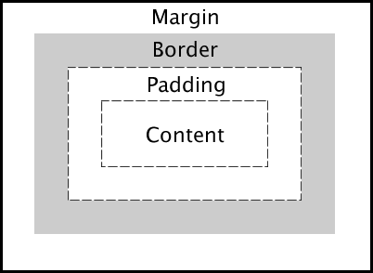

Slide 64
BOX MODEL
Content - The content of the box, where text and images appear
Padding - Clears an area around the content. The padding is transparent
Border - A border that goes around the padding and content
Margin - Clears an area outside the border. The margin is transparent

Slide 65
Example
div { background-color: grey;
margin: 30px;
border: 10px solid blue; padding: 50px;
width: 500px;
height:100px; }

Slide 66
Example
<style>
input{
height: 100px;
width: 50px;
background-color: lightgrey;
}
</style>

Slide 67
CSS Links
a:link { color: red; } /* visited link */ a:visited { color: green; } /* mouse over link */ a:hover { color: yellow;
text-decoration: underline;
background-color: lightgreen; } /* selected link */ a:active { color: blue; }

Slide 68
CSS Tables Styles
table, td, tr {
border: 1px solid black;
border-collapse: collapse;
width: 100%;
height: 50px;
text-align: left;
vertical-align: top/bottom/middle;
}

Slide 69
CSS Position Property
The CSS position property is used to set position for an element. it is also used to place an element behind another and also useful for scripted animation effect.
There are four different position values:
CSS Static Positioning
CSS Fixed Positioning
CSS Relative Positioning
CSS Absolute Positioning

Slide 70
CSS Static Positioning
This is a by default position for HTML elements.
It always positions an element according to the normal flow of the page.
It is not affected by the top, bottom, left and right properties.

Slide 71
div{
position: static; width: 40px;
height: 200px;
border: 3px solid orange;
}

Slide 72
Relative Positioning
Relative positioning changes the position of the HTML element relative to where it normally appears.
So "left:20" adds 20 pixels to the element's LEFT position.

Slide 73
Example
<html> <head>
<style>
div{
position: relative;
left:80px;
top:2px;
background-color : grey;
}
</head>
<body> <div > This div has relative positioning. </div>
</body> </html>

Slide 74
Absolute Positioning
An element with position: absolute is positioned at the specified coordinates relative to your screen top-left corner.
div{
position: absolute; top:100px;
left:50px:
}

Slide 75
div{ position: relative; left: 30px; border: 3px solid red; }

Slide 76
Fixed : It always stays in the same place even if the page is scrolled.
div.fixed { position: fixed; bottom: 0; right: 0; width: 300px; border: 3px solid #73AD21; }

Slide 77
is positioned relative to the nearest positioned ancestor
div.absolute {
position: absolute;
top: 50px;
right: 0;
width: 200px;
height: 100px;
border: 3px solid #73AD21;
}

Slide 78
CSS Layout - float and clear
The CSS float property specifies how an element should float.
The CSS clear property specifies what elements can float beside the cleared element and on which side.

Slide 79
The float Property
The float property is used for positioning and formatting content e.g. let an image float left to the text in a container.
The float property can have one of the following values:
left - The element floats to the left of its container
right - The element floats to the right of its container
none - The element does not float (will be displayed just where it occurs in the text). This is default
inherit - The element inherits the float value of its parent

Slide 80
Bootstrap
Bootstrap is a free and open-source tool collection for creating responsive websites and web applications. It is the most popular HTML, CSS, and JavaScript framework for developing responsive, mobile-first websites.

Slide 81
Advantages
Responsive Design:
Responsive web design is about creating web sites which automatically adjust themselves to look good on all devices, from small phones to large desktops.
Mobile-First Approach:
It prioritizes the mobile experience, with designs that scale up to larger screens.
Pre-designed Components:
Bootstrap offers a wide range of pre-styled components like buttons, forms, modals, and navigation bars, ready for immediate use.
CSS Grid System:
A flexible and responsive grid system allows for easy layout and content distribution.
Customization:
Bootstrap is highly customizable, allowing developers to tailor its appearance and behavior to their specific needs.
Open Source and Free:
Bootstrap is freely available for use and modification.

Slide 82
Bootstrap Grid System
Bootstrap Grid System allows up to 12 columns across the page. You can use each of them individually or merge them together for wider columns. You can use all combinations of values summing up to 12. You can use 12 columns each of width 1, or use 4 columns each of width 3 or any other combination.

Slide 83
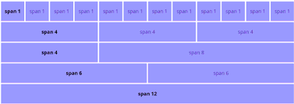

Slide 84
Grid Classes
The Bootstrap grid system has four classes that can be combined to make more flexible layouts:
Xs : For Portrait Mobile Phones.
Sm : For Landscapes phones
Md : For Tablets/Phablets
Lg : For Small-sized Desktops/Laptops
Xl : For Larger-sized Desktops/Laptops

Slide 85
Basic Structure of a Bootstrap Grid
<div class="container"> <div class="row"> <div class="col-*-*"></div> <div class="col-*-*"></div> </div> <div class="row"> <div class="col-*-*"></div> <div class="col-*-*"></div> <div class="col-*-*"></div> </div> <div class="row"> ... </div> </div>

